Slide 1
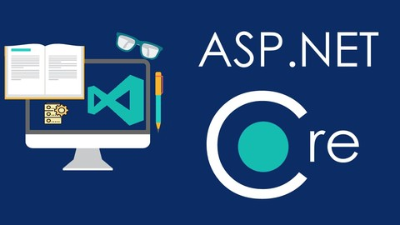
Introduction to ASP.NET Core
Model-View-Controller
SoftUni Team
Technical Trainers
Software University
http://softuni.bg

Slide 2
Table of Contents
What is MVC?
What is its origin?
What is its idea?
What is ASP.NET Core?
What is ASP.NET Core MVC?
Creating our first ASP.NET Core Project

Slide 3
Have a Question?
sli.do #csharp-web

Slide 4

The MVC Pattern

Slide 5
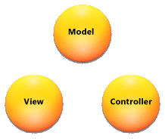
The MVC Pattern
Model–view–controller (MVC) is a software architecture pattern
Originally formulated in the late 1970s by Trygve Reenskaug as part of the Smalltalk
Code reusability and separation of concerns
Originally developed for desktop, then adapted for internet applications

Slide 6
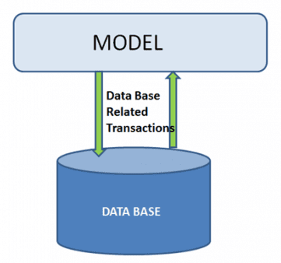
Model
The Model in MVC represents:
A set of classes that describes the data we are working with
Rules for how the data can be manipulated
May contain data validation rules
Often encapsulate persisted data
Most likely a Data Access Layer of some kind
Doesn't have significance in the framework, apart from giving the data objects

Slide 7


View
The View in MVC represents:
Defines how the application’s user interface (UI) will be displayed
May support Master Views (layouts) and Sub-Views (partial views or controls)
Web: Template to dynamically generate HTML

Slide 8

Controller
The Controller in MVC represents:
The core MVC component
Process the requests with the help of Views and Models
A set of classes that handles
Communication from the user
Overall application flow
Application-specific logic
Every Controller has one or more "Actions"

Slide 9
MVC Steps
Incoming Request routed to Controller
For web: HTTP Request
Controller processes Request and creates a Presentation Model
Controller also selects appropriate result (for example: View)
Model is passed to the View
The View transforms Model into appropriate output format (HTML)
Response is rendered (HTTP Response)

Slide 10
The MVC Pattern for Web
HTTP Request
Front controller (dispatcher)
/Some/Page/
Delegate request
User
Controller
HTTP Response
CRUD model
Select view & pass data
View
(render UI)
Model (data)
Use model data

Slide 11
Overall Architecture
Repository
Service
Controller
Database
View
Entities
Models / DTO
Back-End

Slide 12
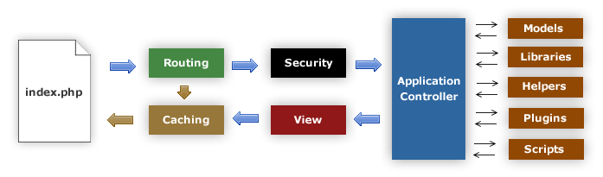
MVC Frameworks
CakePHP (PHP)
CodeIgniter (PHP)
Spring (Java)
Perl: Catalyst, Dancer
Python: Django, Flask, Grok
Ruby: Ruby on Rails, Camping, Nitro, Sinatra
JavaScript: AngularJS, JavaScriptMVC, Spine
ASP.NET MVC (.NET Framework)
ASP.NET Core (.NET Core)

Slide 13
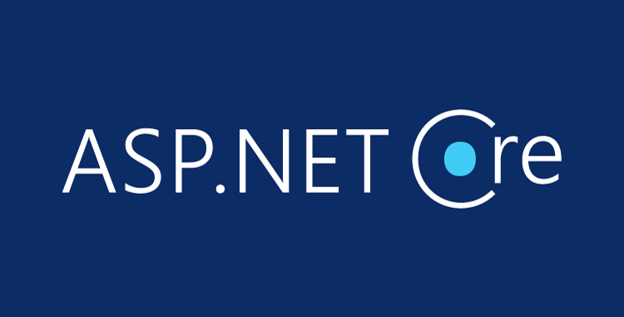
ASP.NET Core Overview

Slide 14
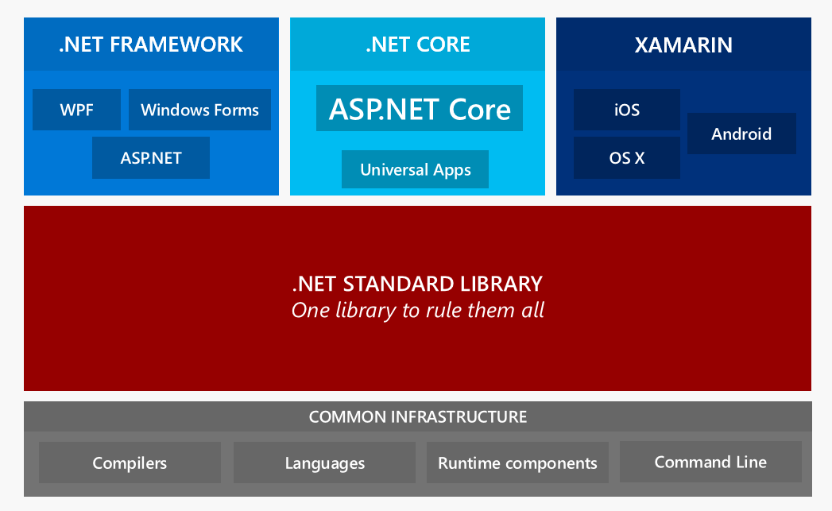
.NET Core: Bird's Eye View

Slide 15
ASP.NET Core Overview
ASP.NET Core is a cross-platform, open-source framework
You can build web applications and services, IoT apps, and mobile backends with ASP.NET Core.
It can be deployed to the cloud (e.g. Azure) or on-premises
ASP.NET Core provides:
Integration of modern client-side frameworks (Angular, Blazor, etc.) and development workflows (MVC, WebAPI, Razor Pages, SignalR)
ASP.NET Core applications run both on .NET Core and .NET Framework

Slide 16
ASP.NET Core Main Features
A unified framework for building web UI and web APIs architected for testability
Ability to develop and run on Windows, macOS, and Linux
Ability to host on IIS, Nginx, Apache, Docker, or self-host in your own process
Cloud-ready, environment-based configuration system
built-in dependency injection
A lightweight, high-performance, and modular HTTP request pipeline (middlewares)
Razor Pages is a page-based programming model that makes building web UI easier
Razor markup provides syntax for Razor Pages, MVC views and Tag Helpers
Model binding automatically maps data from HTTP requests to action method parameters
Model validation automatically performs client-side and server-side validation

Slide 17
ASP.NET vs ASP.NET Core
ASP.NET is a mature framework (v1.0 released January 2002)
Provides the services needed to build enterprise-class, server-based web applications on Windows.
ASP.NET MVC works only on Windows and only in IIS
Latest version: 5.2.5
ASP.NET Core is a relatively new open-source framework (v1.0 released June 2016)
Cross-platform framework
Suitable for building modern, cloud-based web applications on Windows, macOS, or Linux
Latest version: 2.1
2.2 and 3.0 in development

Slide 18
ASP.NET vs ASP.NET Core (2)
ASP.NET MVC
One version per machine
System.Web.dll
Everything is included by default
HTTP Modules, HTTP Handlers, Global.asax
MVC + Web API + Web Pages
Child Actions (Html.Render)
Web.config
ASP.NET Core
Kestrel, Windows, Mac, Linux
Multiple versions per machine
Everything is Nuget packages
Middlewares. All-in-one. Faster.
JSON and environment variables
View Components, Tag Helpers
Build-in DI, logging, services, file providers, WebSockets

Slide 19
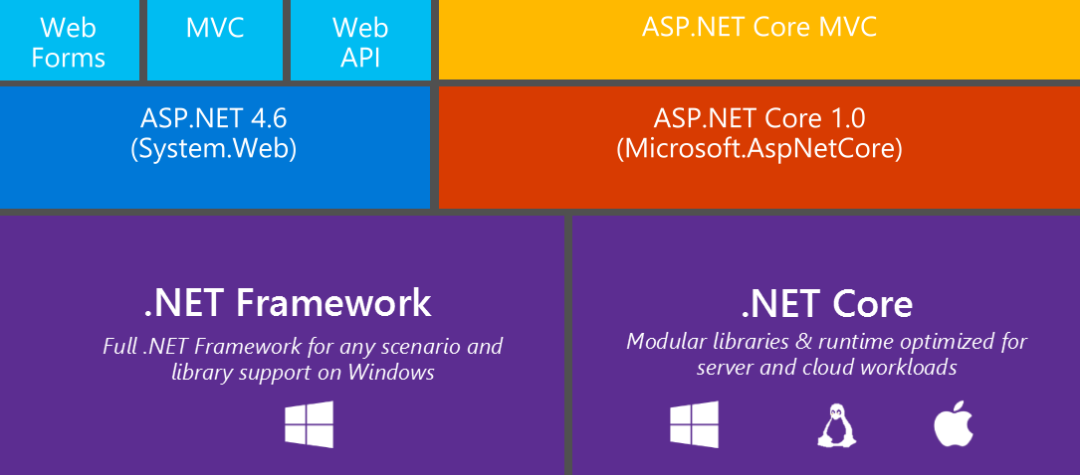
ASP.NET Development Stack Overview

Slide 20
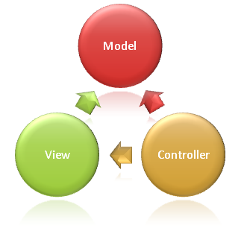
ASP.NET Core MVC Overview

Slide 21
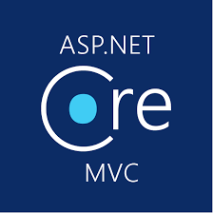
ASP.NET Core MVC
ASP.NET Core MVC is a rich framework for building web apps and APIs
Uses the Model-View-Controller design pattern
Lightweight, Open Source & Highly Testable
Optimized for use with ASP.NET Core
Provides patterns-based ways to build dynamic websites

Slide 22
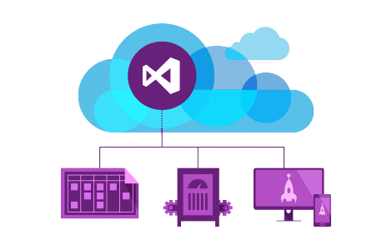
ASP.NET Core MVC
ASP.NET Core MVC makes it easy to:
Create SEO-friendly URLs
Create Single Page applications
Achieve Separation of Concerns
Adopt REST concepts
Implement Test-Driven Development
Achieve high-quality architecture design, optimizing developer work (Convention over Configuration)

Slide 23
ASP.NET Core MVC
ASP.NET Core MVC provides cool features like:
Razor View Engine
One of the greatest view engines
With IntelliSense, integrated in Visual Studio
Support for building Web APIs
Building services that can reach a broad range of clients
Support for cross-origin resource sharing (CORS)

Slide 24


ASP.NET Core MVC
Along with those ASP.NET Core MVC provides features like:
Routing
Model binding & model validation
Dependency injection
Strongly-typed views & view components
Tag helpers
And many more…

Slide 25

Hello, ASP.NET Core
Creating your first ASP.NET Core Projects

Slide 26

Summary
ASP.NET Core is a great platform for developing Web apps
Well-designed, Easily extensible, Highly testable
Has a large (and growing) community
Built from the ground up
But makes development easier for legacy ASP.NET developers
…
…
…

Slide 27
https://softuni.bg/trainings/courses

Slide 28













SoftUni Diamond Partners

Slide 29

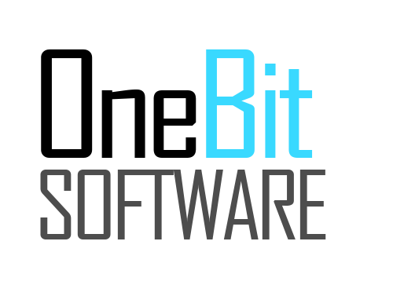



SoftUni Organizational Partners

Slide 30




Trainings @ Software University (SoftUni)
Software University – High-Quality Education and Employment Opportunities
softuni.bg
Software University Foundation
http://softuni.foundation/
Software University @ Facebook
facebook.com/SoftwareUniversity
Software University Forums
forum.softuni.bg

Slide 31

License
This course (slides, examples, demos, videos, homework, etc.) is licensed under the "Creative Commons Attribution-NonCommercial-ShareAlike 4.0 International" license

